Slide 1
AngularJS
Marquis Hu
2017.08.30

Slide 2
Agenda
1
What is AngularJS
2
How to start writing an app
3
Directives
4
Controller
5
Scope
6
Services & DI
7
Routing
8
Testing
8

Slide 3
1
What is AngularJS

Slide 4
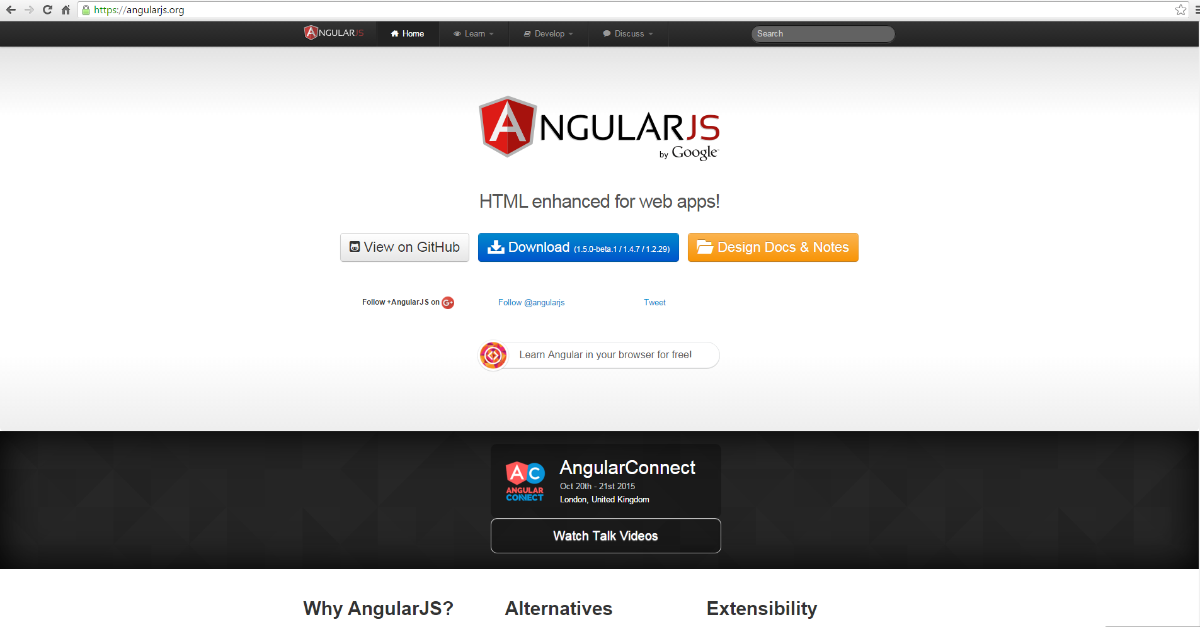
1
What is AngularJS

Slide 5
2
Advantages of AngularJS
Open source JavaScript MVC/MVVM framework.
Easy to extend and customize.
Supports Single Page Application.
Easy to Unit test.
Notes:
2006/2008
Microsoft/Martin Fowler
ViewModel does not need a reference to a view
ViewModel perform all modifications made to the model data
View have no idea that the model exist
ViewModel and Model are unware of the view
Loosely coupled design
Testability
(MVVM)

Slide 6
3
MVC
Controller
user interface logic
and middleman between
various views and model
web
View
Visuals and
user interface
Model
=
database,
REST api,
main business logic
View
visuals and
user interface
mobile

Slide 7
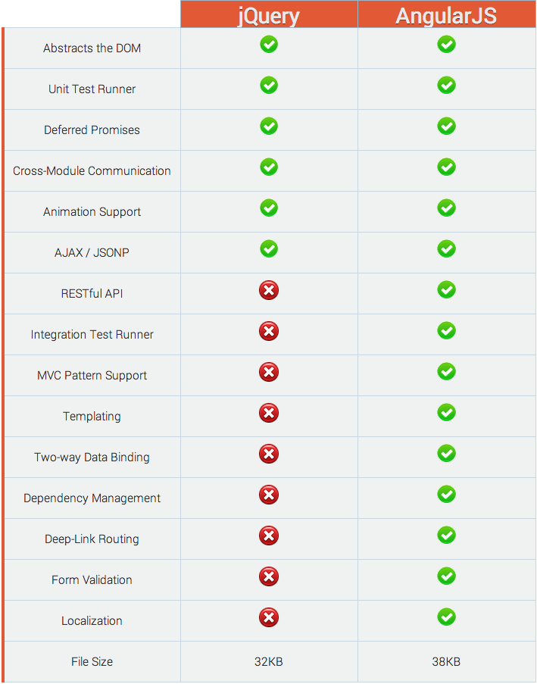
4
Compared To Jquery

Slide 8
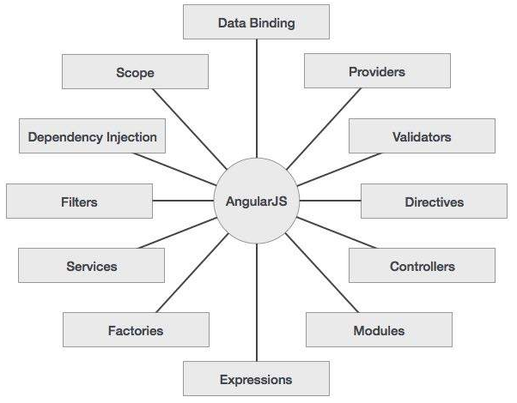
5
Concepts in AngularJS
Notes:
Data-binding − It is the automatic synchronization of data between model and view components.
Scope − These are objects that refer to the model. They act as a glue between controller and view.
Controller − These are JavaScript functions that are bound to a particular scope.
Services − AngularJS come with several built-in services for example $http to make a XMLHttpRequests. These are singleton objects which are instantiated only once in app.
Filters − These select a subset of items from an array and returns a new array.
Directives − Directives are markers on DOM elements (such as elements, attributes, css, and more). These can be used to create custom HTML tags that serve as new, custom widgets. AngularJS has built-in directives (ngBind, ngModel...)
Templates − These are the rendered view with information from the controller and model. These can be a single file (like index.html) or multiple views in one page using "partials".
Routing − It is concept of switching views.
Model View Whatever − MVC is a design pattern for dividing an application into different parts (called Model, View and Controller), each with distinct responsibilities. AngularJS does not implement MVC in the traditional sense, but rather something closer to MVVM (Model-View-ViewModel). The Angular JS team refers it humorously as Model View Whatever.
Deep Linking − Deep linking allows you to encode the state of application in the URL so that it can be bookmarked. The application can then be restored from the URL to the same state.
Dependency Injection − AngularJS has a built-in dependency injection subsystem that helps the developer by making the application easier to develop, understand, and test.

Slide 9
2
How to start writing an app

Slide 10
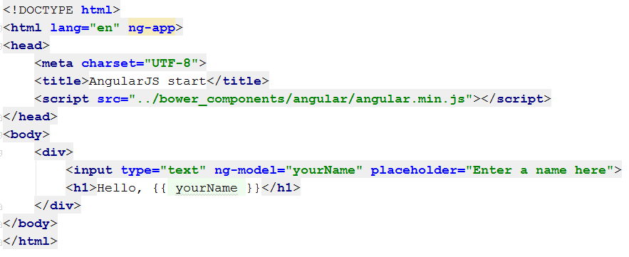
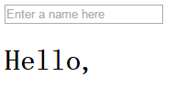
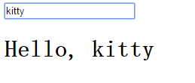
1
How to start writing an app

Slide 11
3
Directives

Slide 12
1
What is directives
Directives are markers on a DOM element (such as an attribute, element name, comment or CSS class) that tell AngularJS's HTML compiler ($compile) to attach a specified behavior to that DOM element (e.g. via event listeners), or even to transform the DOM element and its children.
Marker on a DOM element
Attach a behavior
Transform DOM element or their childs

Slide 13
2
Built-in directive
Application
ng-app
ng-controller
Template
ng-disabled
ng-hide | show
ng-if
ng-mouse
ng-repact
ng-switch
ng-transclude
ng-view
ng-include
ng-csp
Operation
ng-change
ng-checked
ng-click
ng-href
ng-selected
Forms
ng-pattern
ng-minlength
ng-maxlength
ng-required
ng-list
ng-true-value
ng-false-value
ng-options
ng-submit
Binding
ng-bind
ng-model
ng-init
ng-src
ng-style

Slide 14
3
Built-in directive
Angular comes with a set of these directives built-in, like ngBind, ngModel, and ngClass
Directive | Description
ng-app | Auto bootstrap AngularJS application.
ng-init | Initializes AngularJS variables.
ng-model | Binds HTML control's value to a property on the $scope object.
ng-controller | Attaches the controller of MVC to the view.
ng-bind | Replaces the value of HTML control with the value of specified AngularJS expression.
ng-repeat | Repeats HTML template once per each item in the specified collection.
ng-show | Display HTML element based on the value of the specified expression.
ng-readonly | Makes HTML element read-only based on the value of the specified expression.
ng-disabled | Sets the disable attribute on the HTML element if specified expression evaluates to true.
ng-if | Removes or recreates HTML element based on an expression.
ng-click | Specifies custom behavior when an element is clicked.

Slide 15
4
Custom Directives
Custom directives are used in AngularJS to extend the functionality of HTML. Custom directives are defined using "directive" function. A custom directive simply replaces the element for which it is activated. There are four types of custom directives:
A-Attribute directives
E-Element directives
C-CSS class directives
M-Comment directives

Slide 16
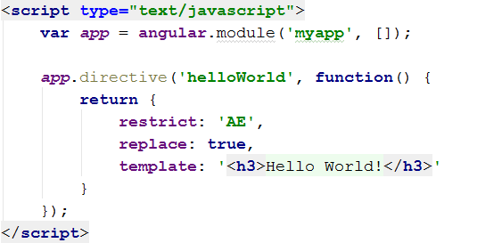
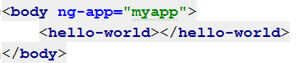
5
Create a simple directive

Slide 17
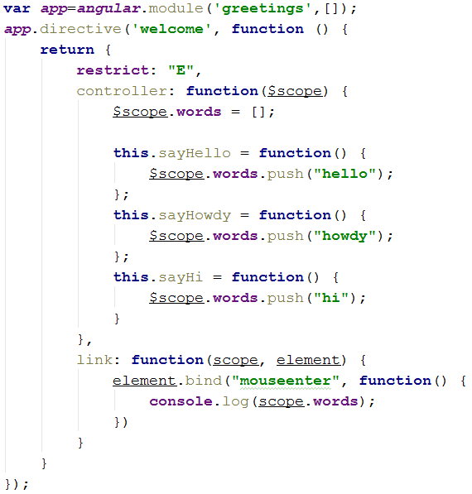
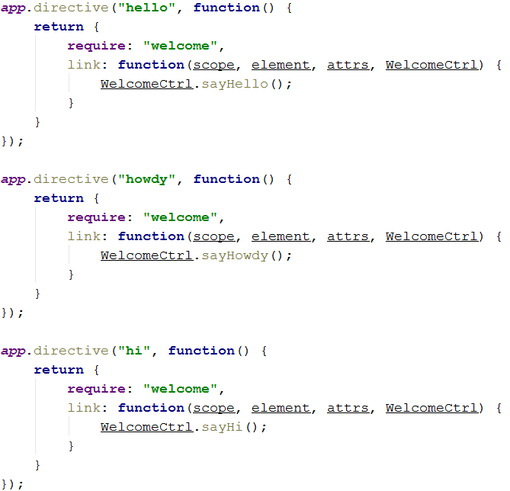
6
Exercise

Slide 18
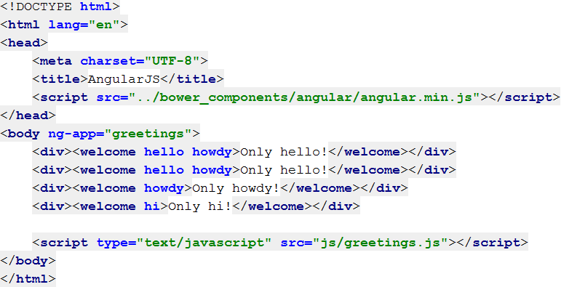
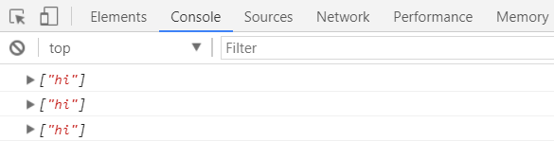
7
Exercise

Slide 19
8
How it work
compile
controller
pre-link
post-link

Slide 20
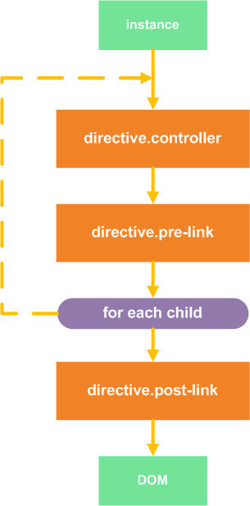
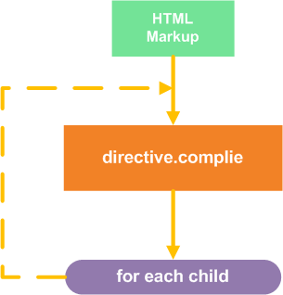
9
Compile and Link
The compile phase
The link phase

Slide 21
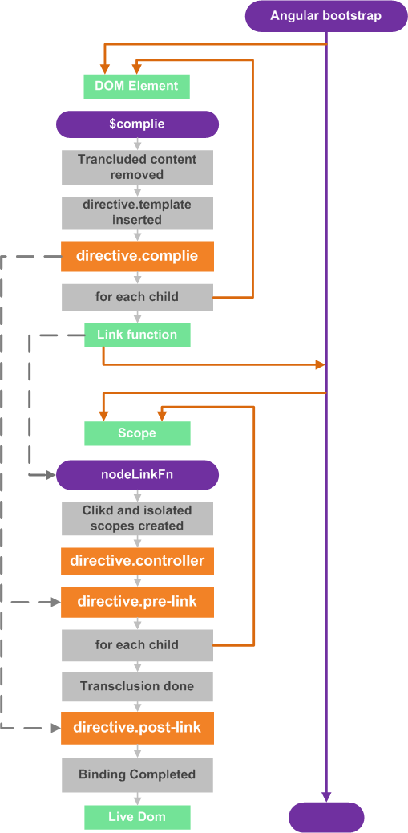
10
Execution order

Slide 22
4
Controller

Slide 23
1
Introduction
AngularJS application mainly relies on controllers to control the flow of data in the application. A controller is defined using ng-controller directive. A controller is a JavaScript object containing attributes/properties and functions. Each controller accepts $scope as a parameter which refers to the application/module that controller is to control.

Slide 24
2
How to use controller
Use controllers to:
Set up the initial state of the $scope object.
Add behavior to the $scope object.
Do not use controllers to:
Manipulate DOM — Controllers should contain only business logic. Putting any presentation logic into Controllers significantly affects its testability. Angular has databinding for most cases and directives to encapsulate manual DOM manipulation.
Format input — Use angular form controls instead.
Filter output — Use angular filters instead.
Share code or state across controllers — Use angular services instead.
Manage the life-cycle of other components (for example, to create service instances).

Slide 25
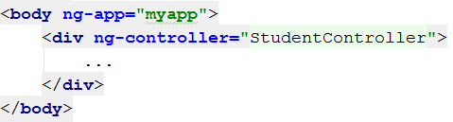
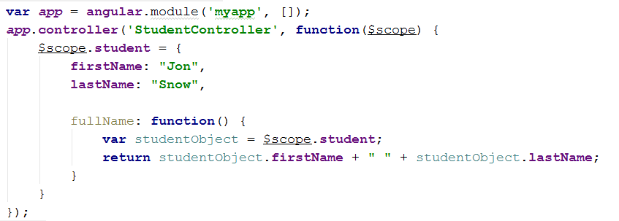
3
Sample
Here we've declared a controller studentController using ng-controller directive. As a next step we'll define the studentController as follows.
Notes:
studentController defined as a JavaScript object with $scope as argument.
$scope refers to application which is to use the studentController object.
$scope.student is property of studentController object.
firstName and lastName are two properties of $scope.student object. We've passed the default values to them.
fullName is the function of $scope.student object whose task is to return the combined name.
In fullName function we're getting the student object and then return the combined name.
As a note, we can also defined the controller object in separate JS file and refer that file in the html page.

Slide 26
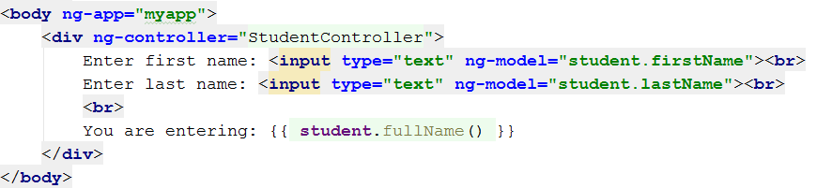
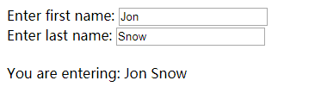
4
Sample
Now we can use studentController's student property using ng-model or using expressions as follows.
Notes:
We've bounded student.firstName and student.lastname to two input boxes.
We've bounded student.fullName() to HTML.
Now whenever you type anything in first name and last name input boxes, you can see the full name getting updated automatically.

Slide 27
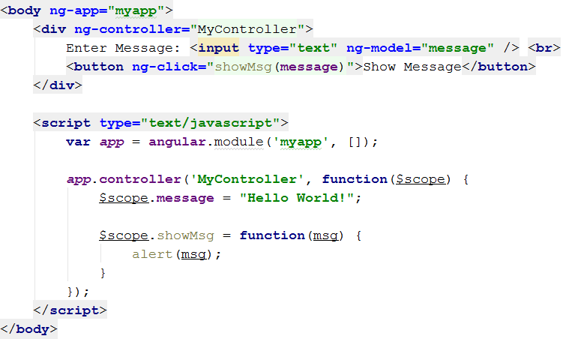
5
Sample
Attach behaviors.
Notes:
We've bounded student.firstName and student.lastname to two input boxes.
We've bounded student.fullName() to HTML.
Now whenever you type anything in first name and last name input boxes, you can see the full name getting updated automatically.

Slide 28
5
Scope

Slide 29
1
What are scopes in AngularJS
The glue between controller and view
Scope is an object
Context for expressions
Hierarchical structure
Propagate event
View
Controller
$scope

Slide 30
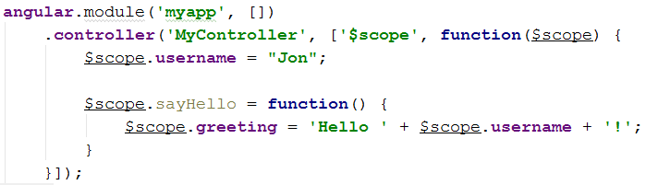
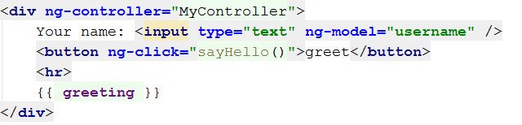
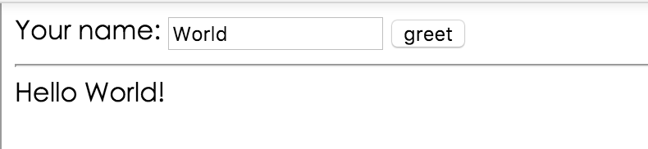
2
Scope in Controller

Slide 31
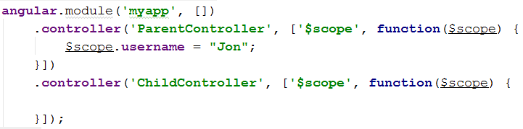
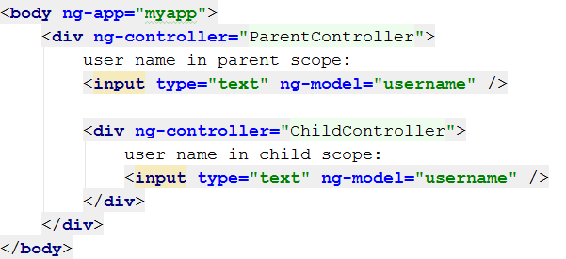
3
Scopes nested/Data inheritance

Slide 32
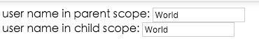
4
Scopes nested/Data inheritance

Slide 33
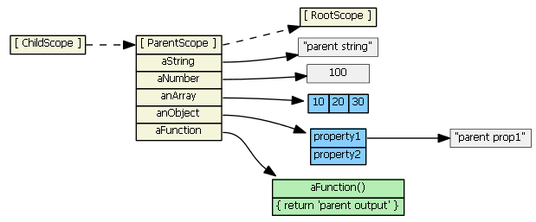
5
Scopes nested/Data inheritance
AngularJS Sopes data Inheritance
childScope.aString === 'parent string'
childScope.anArray[1] === 20
childScope.anObject.property1 === 'parent prop1'
childScope.aFunction() === 'parent output'
True or False?

Slide 34
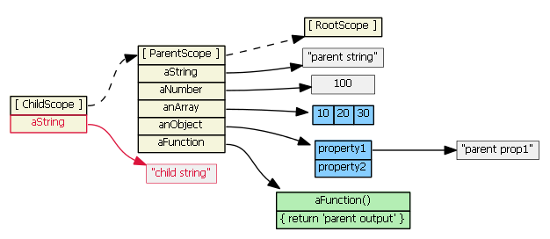
6
Scopes nested/Data inheritance
childScope.aString = 'child string'

Slide 35
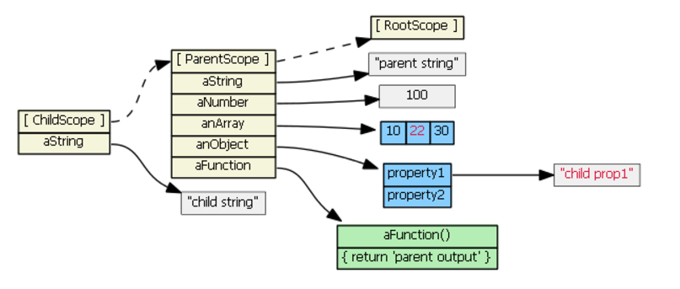
7
Scopes nested/Data inheritance
childScope.anArray[1] = 22
childScope.anObject.property1 = ‘child prop1’

Slide 36
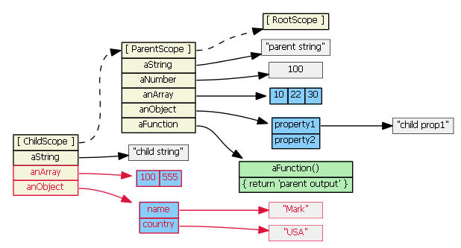
8
Scopes nested/Data inheritance
childScope.anArray = [100, 555]
childScope.anObject = { name: 'Mark', country: 'USA' }

Slide 37
9
Scopes nested/Data inheritance
AngularJs Scope Inheritance
ng-controller
ng-include
ng-switch
ng-view
ng-repeat
Scope API for parent-child relationship
$parent
$$childHead
$$childTail

Slide 38
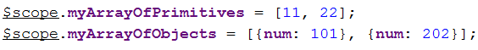
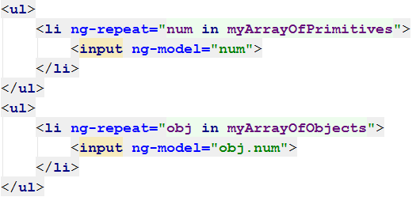
10
Scope for ng-repeat
Suppose have below fields in parent controller:
HTML content in Child controller:

Slide 39
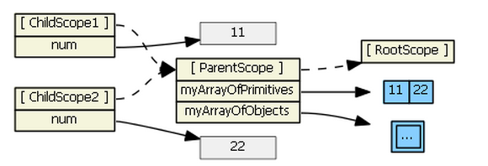
11
Scope for ng-repeat
Scopes inheritance relationship for : myArrayOfPrimitives

Slide 40
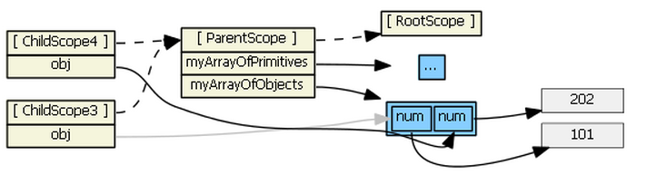
12
Scope for ng-repeat
Scopes inheritance relationship for : myArrayOfObjects

Slide 41
13
Scope for directive
Scope : False ( Directive uses its parent scope )
Scope : True ( Directive gets a new scope )
Scope : { } ( Directive gets a new isolated scope )
"@" ( Text binding / one-way binding )
"=" ( Direct model binding / two-way binding )
"&" ( Behaviour binding / Method binding )
Different types of directive scopes

Slide 42
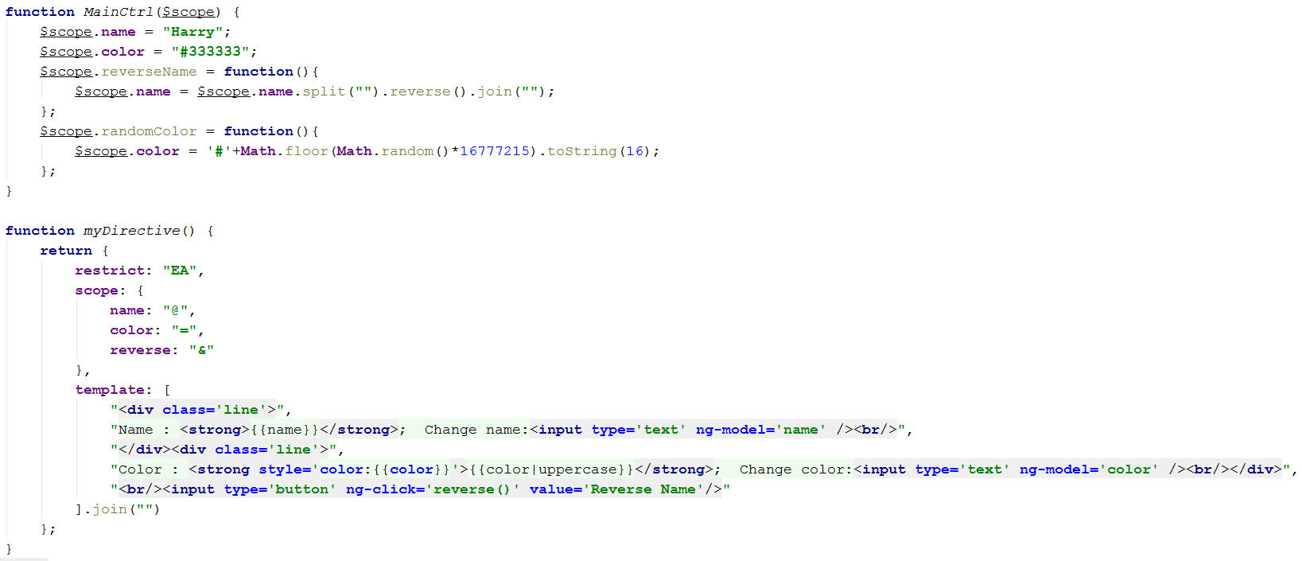
14
Isolated scope for directive

Slide 43
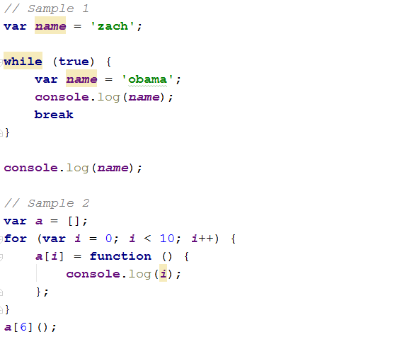
15
Scope in ES5

Slide 44
16
Summay
Normal prototypal scope inheritance
ng-include, ng-switch,ng-controller, directive with “scope:true”
Normal prototypal scope inheritance with a copy/assignment
ng-repeat
Isolate Scope
Transcluded scope

Slide 45
6
Services & DI

Slide 46
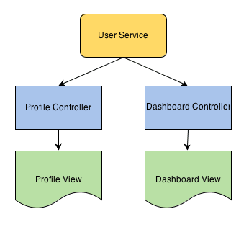
1
Introduction
Angular services are substitutable objects that are wired together using dependency injection (DI). You can use services to organize and share code across your app.

Slide 47
2
Introduction
Lazily instantiated – Angular only instantiates a service when an application component depends on it.
Singletons – Each component dependent on a service gets a reference to the single instance generated by the service factory.

Slide 48
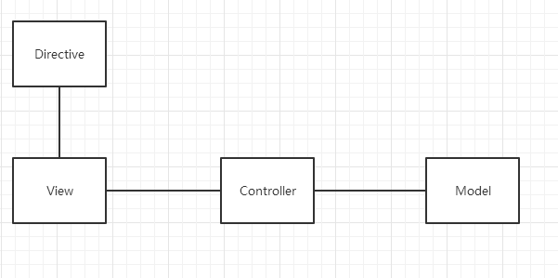
3
Why we need Service
Directives are markers on a DOM element that tell AngularJS's HTML compiler($compile) to attach a specified behavior to that DOM element or even to transform the DOM element and its children.
Controllers set up the initial state of the $scope object and add behavior to the $scope object.
Is that enough?

Slide 49
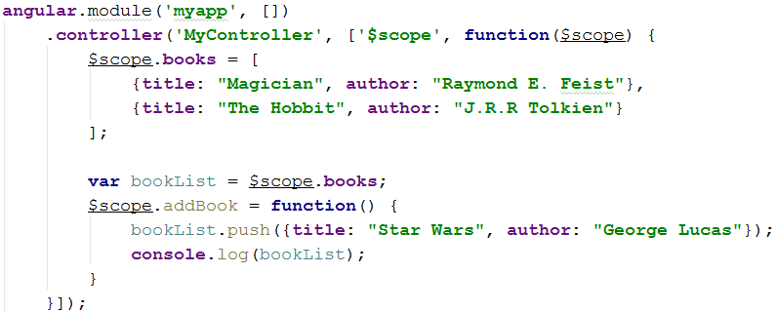
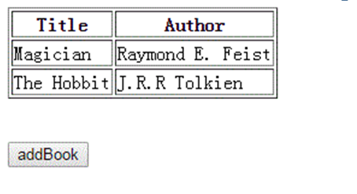
4
Example

Slide 50
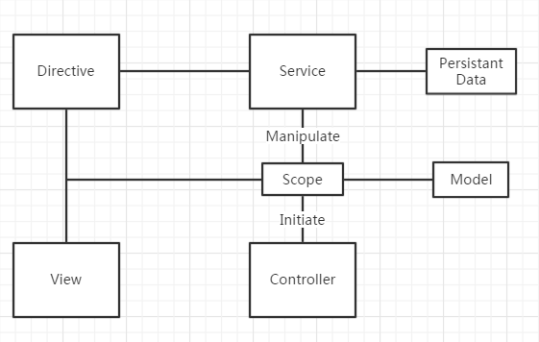
5
Why we need Service
How relate Directive to Controller?

Slide 51
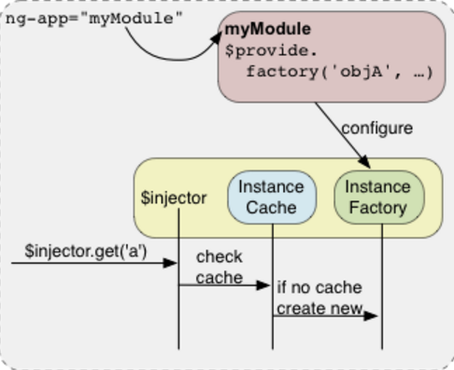
6
Service work with injector

Slide 52
7
Internal Services
$animate
$cookies
$document
$http
$location
$rootScope
$route
......

Slide 53
8
Custom Services
Constant
Value
Service
Factory
Provider

Slide 54
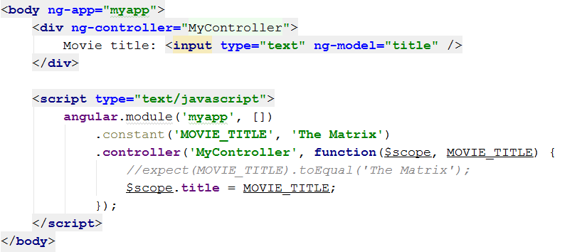
9
Constant
A constant can be injected everywhere. A constant can not be intercepted by a decorator, that means that the value of a constant should never be changed (though it is still possible to change it programmatically in Angular 1.x).

Slide 55
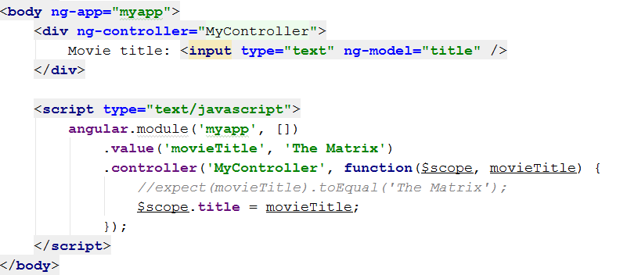
10
Value
A value is nothing more than a simple injectable value. The value can be a string, number but also a function. Value differs from constant in that value can not be injected into configurations, but it can be intercepted by decorators.

Slide 56
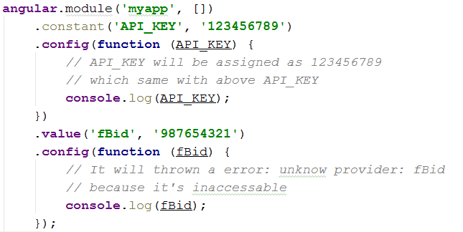
11
Constant & Value

Slide 57
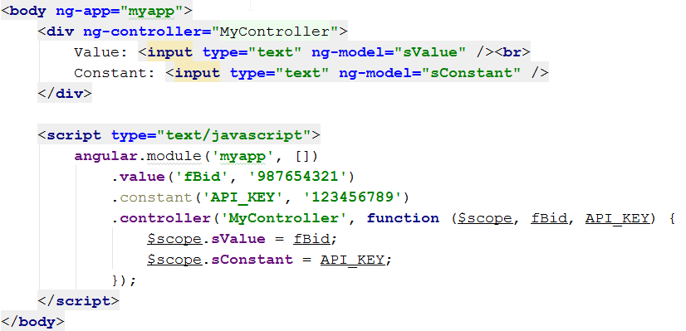
12
Constant & Value

Slide 58
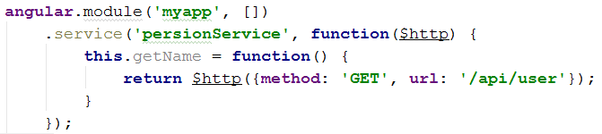
13
Service
Use Service when you need just a simple object such as a Hash, for example {foo:1, bar:2} It's easy to code, but you cannot instantiate it. A service is an injectable constructor. If you want you can specify the dependencies that you need in the function. A service is a singleton and will only be created once by AngularJS. Services are a great way for communicating between controllers like sharing data.

Slide 59
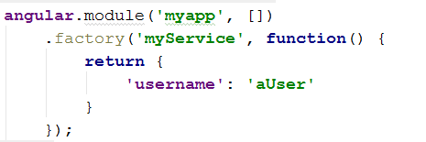
14
Factory
A factory is an injectable function. A factory is a lot like a service in the sense that it is a singleton and dependencies can be specified in the function. The difference between a factory and a service is that a factory injects a plain function so AngularJS will call the function and a service injects a constructor. A constructor creates a new object so new is called on a service and with a factory you can let the function return anything you want. As you will see later on, a factory is a provider with only a $get method.

Slide 60
15
Provider
A provider is the most sophisticated method of all the providers. It allows you to have a complex creation function and configuration options. A provider is actually a configurable factory. The provider accepts an object or a constructor.

Slide 61
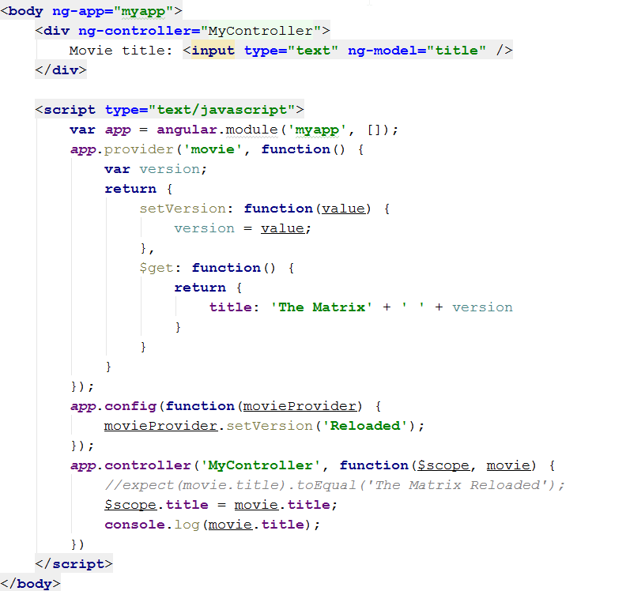
16
Provider

Slide 62
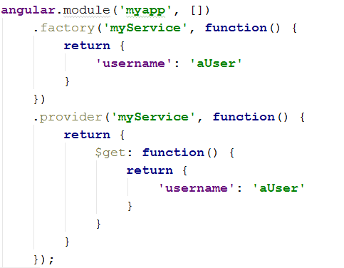
17
Factory & Provider

Slide 63


18
Example

Slide 64

19
Example

Slide 65
20
Summary
Provider | Singleton | Instantiable | Configurable
Constant | Yes | No | No
Value | Yes | No | No
Service | Yes | No | No
Factory | Yes | Yes | No
Provider | Yes | Yes | Yes

Slide 66
21
Summary
All the providers are instantiated only once. That means that they are all singletons.
All the providers except constant can be decorated.
A constant is a value that can be injected everywhere. The value of a constant can never be changed.
A value is just a simple injectable value.
A service is an injectable constructor.
A factory is an injectable function.
A decorator can modify or encapsulate other providers except a constant.
A provider is a configurable factory.

Slide 67
7
Routing

Slide 68
1
Why need routing
AngularJS supports SPA using routing module ngRoute. This routing module acts based on the url. When a user requests a specific url, the routing engine captures that url and renders the view based on the defined routing rules.
Application (root) module
Module
Other Modules
Config
Routes
View
$scope
Controller
Directive
Factorise/
Services

Slide 69


2
View and Template
AngularJS supports Single Page Application via multiple views on a single page. To do this AngularJS has provided ng-view and ng-template directives and $routeProvider services
Define a div with ng-view within the main module
Define a script block with type as ng-template within the main module.

Slide 70

3
Route Provider
$routeProvider is the key service which set the configuration of urls, map them with the corresponding html page or ng-template, and attach a controller with the same
Define a script block with main module and set the routing configuration

Slide 71


4
Sample
AngularJS supports Single Page Application via multiple views on a single page. To do this AngularJS has provided ng-view and ng-template directives and $routeProvider services
1
Layout page main.html
TIPS
Template

Slide 72

5
Sample
TIPS

Slide 73



6
Sample
TIPS: #/person
TIPS:
#/admin

Slide 74
8
Testing

Slide 75
E2E Test
Unit Test

Slide 76
1
E2E Testing
Protractor is built on top of
WebDriverJS
Testing system (NodeJS, Java, etc)
|
Webdriver (a.k.a. Selenium)
|
Your AngularJS App

Slide 77


Slide 78
2
Unit Testing
Recommended Unit Testing Tools
Jasmine - Jasmine is a behavior-driven development framework for testing JavaScript code.
Mocha - The fun, simple, flexible JavaScript test framework.
Qunit - A JavaScript Unit Testing framework, used by jQuery.

